Slide 1
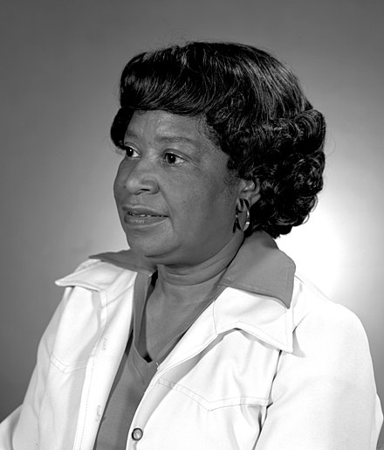
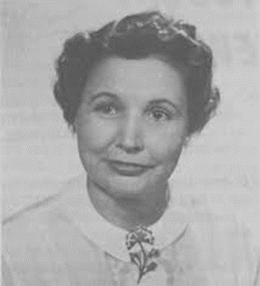
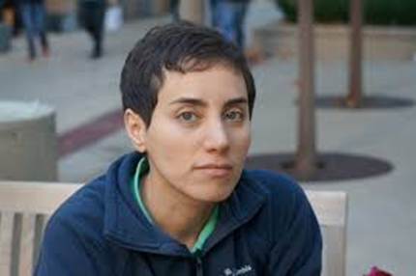

Women of Color in Mathematics: Mary Jackson, Mary G. Ross, and Maryam Mirzakhani
A brief look at the often overlooked pioneers in mathematics through the lives of Mary & Mary & Mary

Slide 2

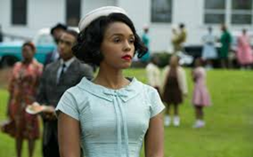
Mary Jackson April 9, 1921 – February 11, 2005
A mathematician that pushed her own boundaries to become a trailblazing engineer

Slide 3
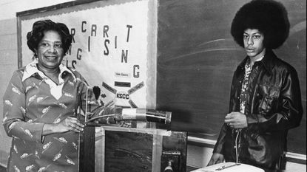
Mary Jackson: Beginnings
She was born and raised in Hampton, Virginia on April 9, 1921
After graduating from high school with highest honors, she earned a dual degree in mathematics and physical science at the Hampton Institute (now Hampton University) in 1942
She worked as a math teacher in Maryland for a year before returning to Hampton

Slide 4
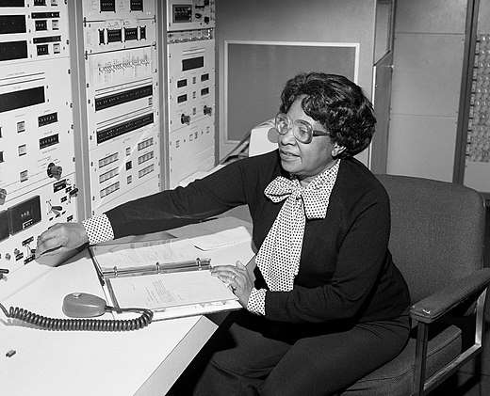
Mary Jackson: Career at NACA/NASA
In 1951, Jackson was recruited by the National Advisory Committee for Aeronautics (NACA)
In 1958 was succeeded by the National Aeronautics and Space Administration (NASA).
She started as a research mathematician, or computer, at the Langley Research Center in her hometown of Hampton, Virginia. She worked under Dorothy Vaughan in the segregated West Area Computing Section
In 1953, she accepted an offer to work for engineer Kazimierz Czarnecki in the Supersonic Pressure Tunnel

Slide 5
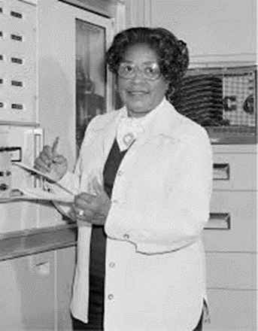
Mary Jackson: A New Beginning
Czarnecki encouraged Jackson to undergo training so that she could be promoted to an engineer, however, she needed to take graduate-level courses in mathematics and physics to qualify for the job
Classes were offered in a night program by the University of Virginia, held at the all-white Hampton High School. Jackson petitioned the City of Hampton to allow her to attend the classes.
After completing the courses, she was promoted to aerospace engineer in 1958, and became NASA's first black female engineer

Slide 6
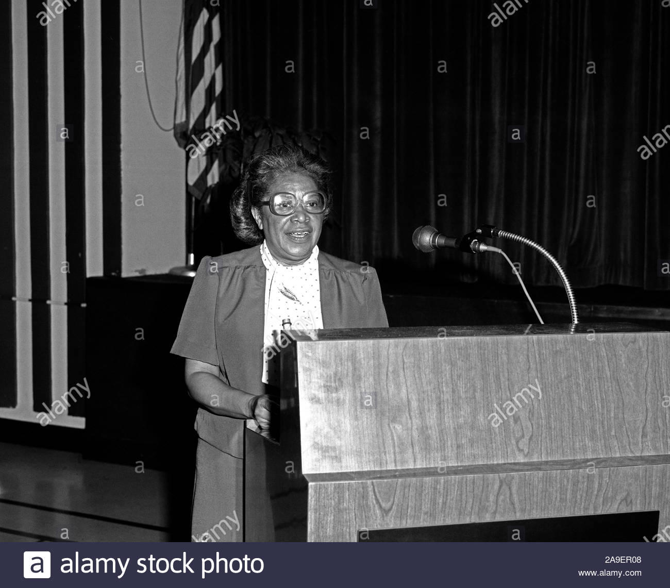
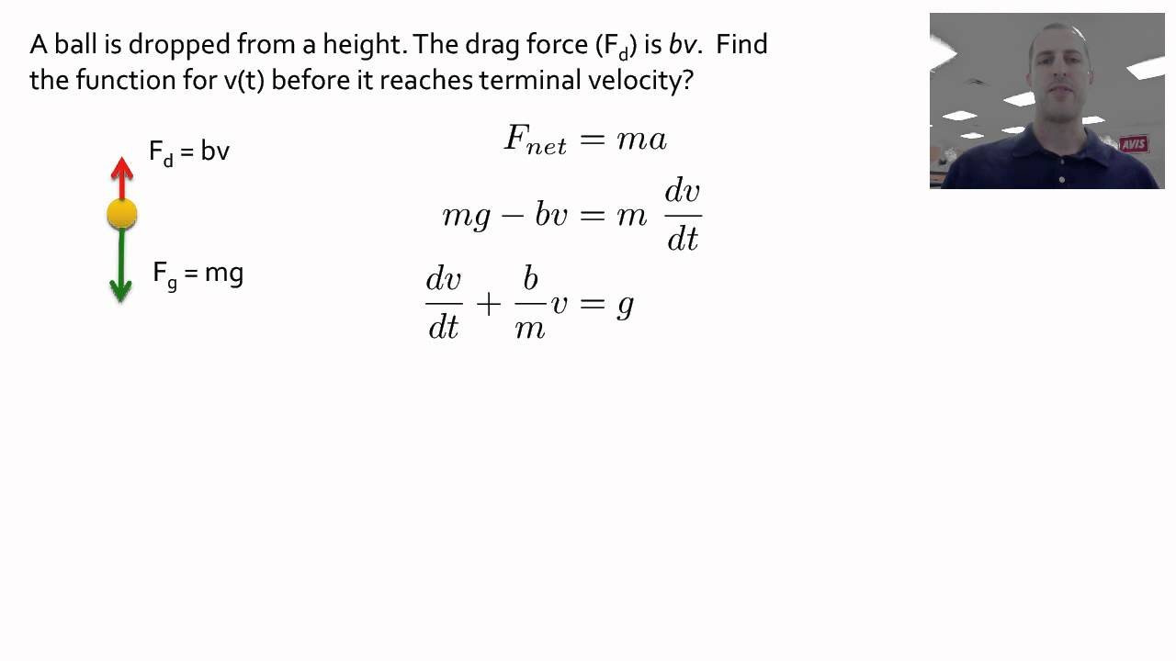
Mary Jackson: What exactly did she do?
As an engineer, Jackson analyzed data from wind tunnel experiments and real-world aircraft flight experiments
Her goal was to understand air flow, including thrust and drag forces, in order to improve United States planes
Drag force is often solved through using differentials, as the drag force is proportional to the velocity of the object (as the velocity goes up, so does the drag force)

Slide 7
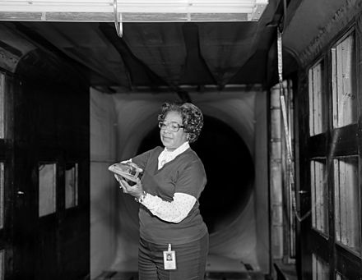
Jackson holding a wind tunnel model

Slide 8
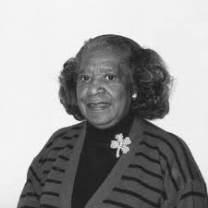
Mary Jackson: Quote
After helping the kids in the science club at Hampton’s King Street Community center build their own wind tunnel, in a newspaper article she stated, “We have to do something like this to get them interested in science. Sometimes they are not aware of the number of black scientists, and don't even know of the career opportunities until it is too late."

Slide 9
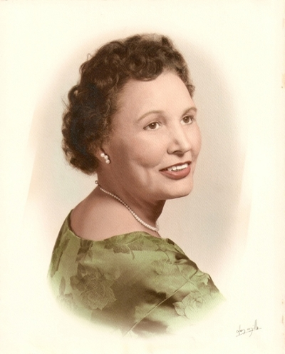
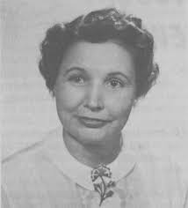
Mary G. Ross August 9, 1908 – April 29, 2008
An aerospace engineer who reached for the stars

Slide 10
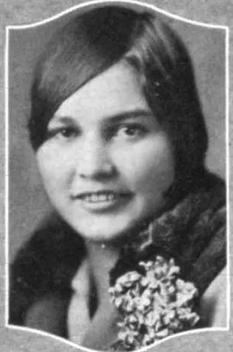
Mary G Ross: Beginnings
Born in 1908, Mary Golda Ross grew up in Park Hill, Okla.
Her great-great grandfather was Cherokee Chief John Ross, who led the Cherokee Nation during the traumatic and turbulent Indian Removal era of the 1830s
When she was 16, Ross enrolled in Northeastern State Teachers' College in Tahlequah. She earned a bachelor's degree in mathematics in 1928, at age 20
She received her master's degree from the Colorado State Teachers College in Greeley in 1938, taking every astronomy class they had.

Slide 11
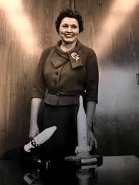
Mary G Ross: Career
Ross was hired as a mathematician by Lockheed in 1942. While there she began working on the effects of pressure on the Lockheed P-38 Lightning (the first military airplane to fly faster than 400 mph in level flight)
Ross helped to solve numerous design issues involved with high speed flight and issues of aeroelasticity.
In 1952, she joined Lockheed's Advanced Development Program at the then-secret Skunk Works, where she worked on "preliminary design concepts for interplanetary space travel, manned and unmanned earth-orbiting flights, the earliest studies of orbiting satellites for both defense and civilian purposes.“
She became the first known Native American female engineer

Slide 12
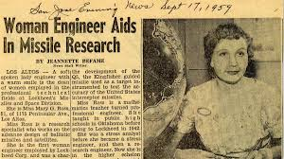
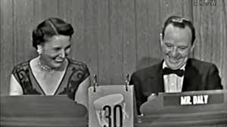
Mary G Ross: What did she really do?
Much of her research and writing at the Skunk Works remains classified, even today
As she stated, "We were taking the theoretical and making it real."
She worked on the Agena rocket project and on preliminary design concepts for flyby missions to Venus and Mars
As one of her coworkers stated, “Mary worked on the Agena rocket orbital dynamics, calculating the transfer orbit as the rocket left the Earth’s atmosphere. Today’s engineer would use the computer program, MATLAB, and insert the parameter to determine when the rocket would reach its destination.”

Slide 13
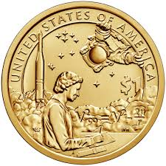
Ross as featured on the 2019 US one dollar coin

Slide 14
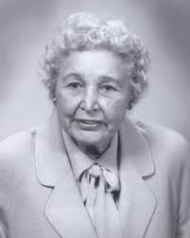
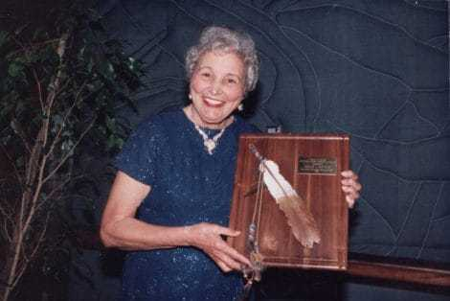
Mary G Ross: Quote
“I was brought up in the Cherokee tradition of equal education for boys and girls. It did not bother me to be the only girl in the math class.”

Slide 15

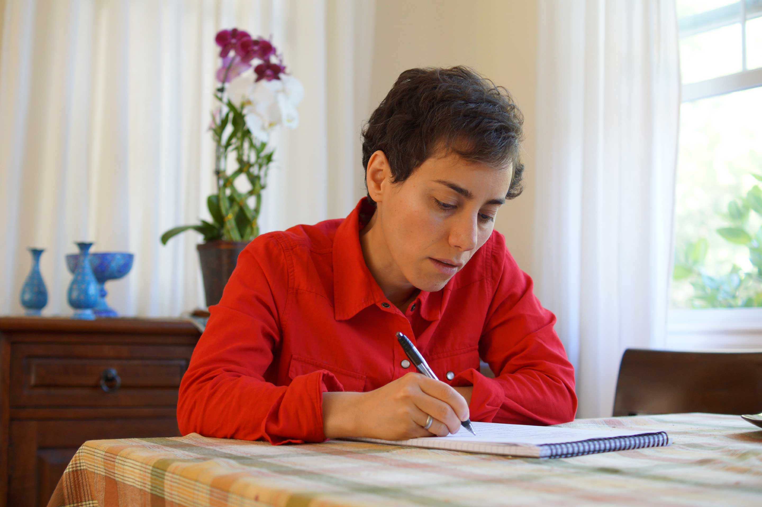
Maryam Mirzakhani 12 May 1977 – 14 July 2017
A record-breaking mathematician who had a more artistic view at complex math

Slide 16

Maryam Mirzakhani: Beginnings
Mirzakhani was born on 12 May 1977 in Tehran, Iran
In her junior and senior year of high school, she won the gold medal for mathematics in the Iranian National Olympiad, thus allowing her to bypass the national college entrance exams.
In 1994, Mirzakhani achieved the gold medal level in the International Mathematical Olympiad in Hong Kong, scoring 41 out of 42 points and she was the first female Iranian student to do so
in 1995, she became the first Iranian student to achieve a perfect score and to win two gold medals in the International Mathematical Olympiad held in Toronto
In 1999, she obtained a Bachelor of Science in mathematics from the Sharif University of Technology. During her time there, she received recognition from the American Mathematical Society for her work in developing a simple proof for a theorem of Schur
She earned a PhD in 2004 from Harvard University for her dissertation Simple Geodesics on Hyperbolic Surfaces and Volume of the Moduli Space of Curves

Slide 17
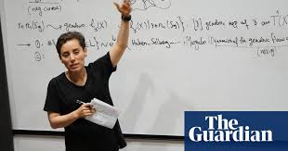
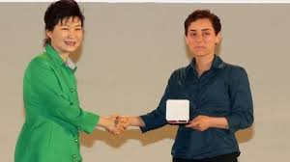
Maryam Mirzakhani: Career
Mirzakhani was a 2004 research fellow of the Clay Mathematics Institute and a professor at Princeton University.
In 2009, she became a professor at Stanford University
Mirzakhani was awarded the Fields Medal in 2014 for "her outstanding contributions to the dynamics and geometry of Riemann surfaces and their moduli spaces“ becoming the first woman and the first Iranian to be awarded a Fields Medal
The Fields Medal is regarded as one of the highest honors a mathematician can receive, and has been described as the mathematician's Nobel Prize,

Slide 18
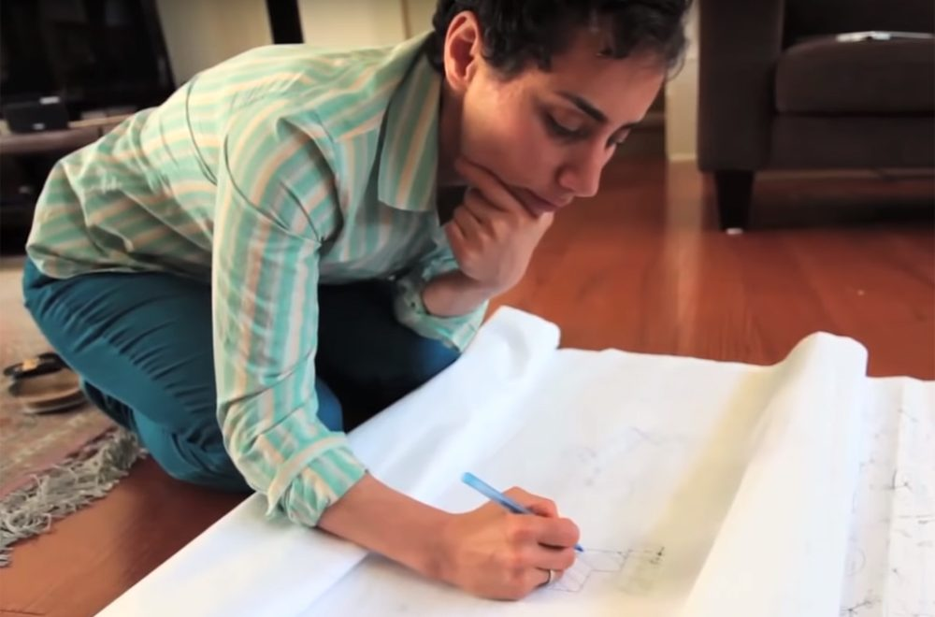
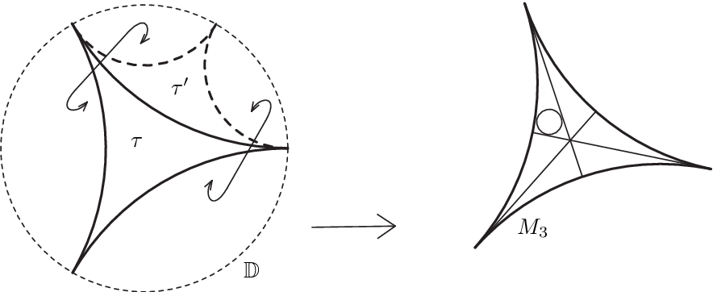
Maryam Mirzakhani: What did she really do?
Mirzakhani's early work solved the problem of counting simple closed geodesics on hyperbolic Riemann surfaces by finding a relationship to volume calculations on moduli space
A geodesic is a curve representing in some sense the shortest path between two points in a surface
Her subsequent work focused on Teichmüller dynamics of moduli space. In particular, she was able to prove the long-standing conjecture that William Thurston's earthquake flow on Teichmüller space is ergodic
An ergodic system is a stochastic process (a family of random variables) which proceeds in time and which has the same statistical behavior averaged over time as over the system's entire possible state space (set of all possible configurations of a system)
The idea of ergodicity was born in the field of thermodynamics, where it was necessary to relate the individual states of gas molecules to the temperature of a gas as a whole and its time evolution thereof
In non-technical terms, ergodicity in a physical system means the system does not get “stuck” in a mode

Slide 19
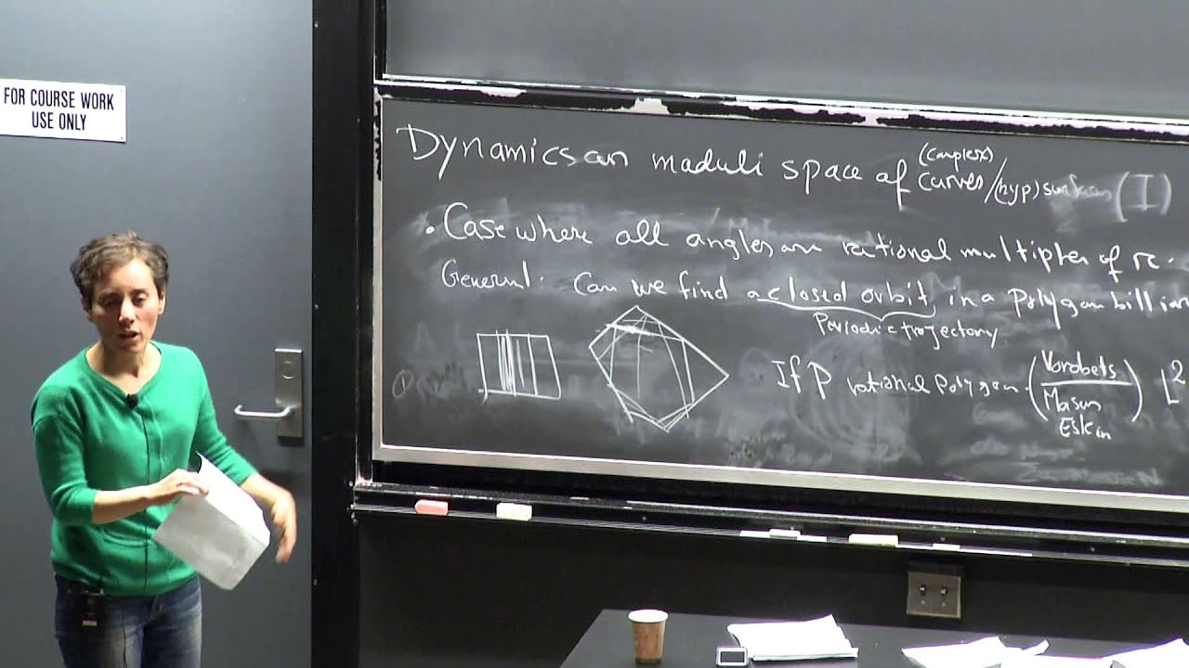
Lecture of Maryam Mirzakhani of Saturday, November 22, 2014 at the conference Current Developments in Mathematics 2014. The title of the talk was "Dynamics on Moduli Spaces of Curves I"

Slide 20
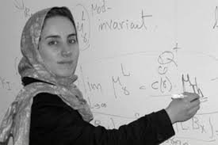
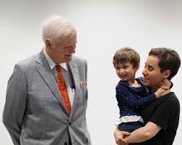
Maryam Mirzakhani: Quote
“I don't have any particular recipe [for developing new proofs] ... It is like being lost in a jungle and trying to use all the knowledge that you can gather to come up with some new tricks, and with some luck, you might find a way out.”

Slide 21
Thank you!

Slide 22
Works cited
https://www.britannica.com/biography/Mary-Jackson-mathematician-and-engineer
https://www.nasa.gov/content/mary-jackson-biography
https://www.americanindianmagazine.org/story/mary-golda-ross-she-reached-stars
https://www.britannica.com/biography/Maryam-Mirzakhani

